Slide 1
Lec -11
PHYSICAL LAYER: Modulation & Multiplexing
(Digital to Digital Conversion , Analog to Digital Conversion , Analog to Analog conversion, Digital to Analog conversion ,
Multiplexing )

Slide 2
What is Modulation and Demodulation ?
Modulation is defined as in which data or information is changed into electrical or digital signals for transferring that signal over a medium is called modulation.
Demodulation – It is a type of process which converts Analog signals into digital signals .
Example of Modulation and Demodulation - A Modem device is the classic example of both modulation and demodulation processes.

Slide 3
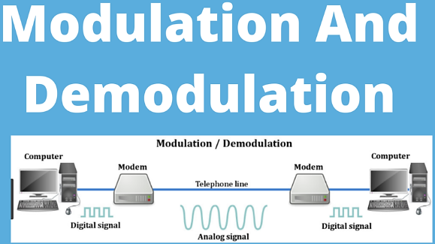
How Modulation and Demodulation performs ?

Slide 4
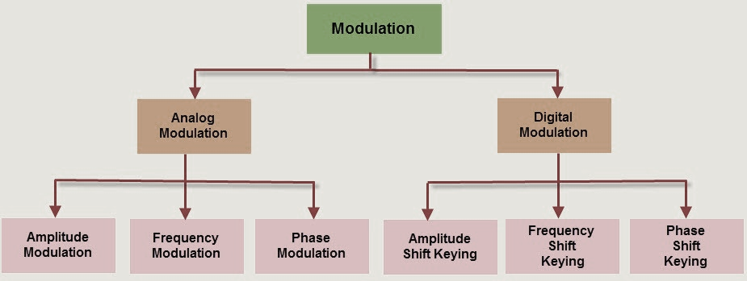
Types of modulation .

Slide 5
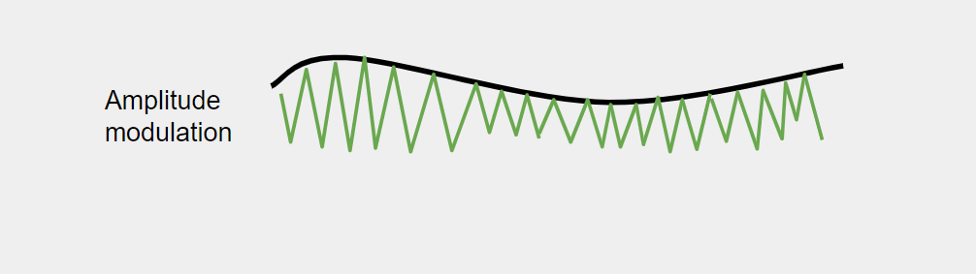
Types of Analog modulation.
Amplitude modulation: It is a type of modulation in which only the amplitude of the carrier signal is varied to represent the data being added to the signals.

Slide 6
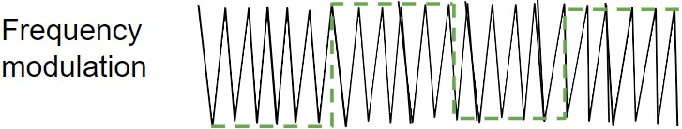
Frequency modulation: It is a type of modulation in which only the frequency of the carrier signal is varied to represent the frequency of the data.

Slide 7
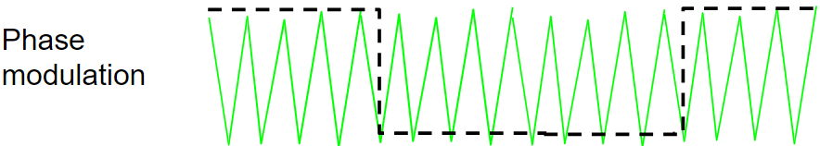
3. Phase modulation: It is a type of modulation in which the phase of the carrier signal is varied to represent the data being added to the signal.

Slide 8
What is Digital Modulation ?
Digital modulation
It is a type of method in which discrete signals are used to modulate carrier waves and remove noise from the waves is known as digital modulation.
In the Digital Modulation a digital signal, representing the binary digits whose value is 0 and 1 by a series of on and off amplitudes, is impressed onto an analog carrier wave of constant amplitude and frequency.

Slide 9
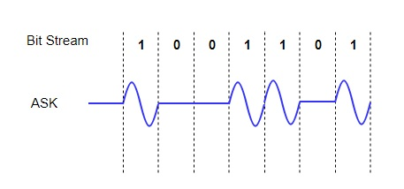
Types of Digital Modulation .
Amplitude Shift Keying (ASK) -
It is type of method signal level is represented by variations in the amplitude of the signal. In ASK only the amplitude is varied keeping phase and frequency constant.

Slide 10
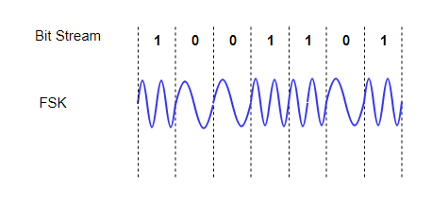
Frequency shift keying .
Frequency Shift Keying (FSK)
In the frequency shift keying method the signal level is represented by variations in the frequency of the signal. In this method only the frequency is varied keeping amplitude and phase constant. We then use different frequency levels to show the signal levels 0 and 1.

Slide 11
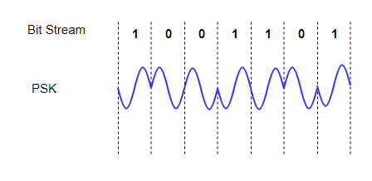
What is PSK ?
Phase Shift Keying (PSK)
In this method the variation in phase of the signal in this method represents the signal level. In PSK only the frequency is varied keeping amplitude and frequency constant. Also we use different phases to show the signal levels 0 and 1.

Slide 12
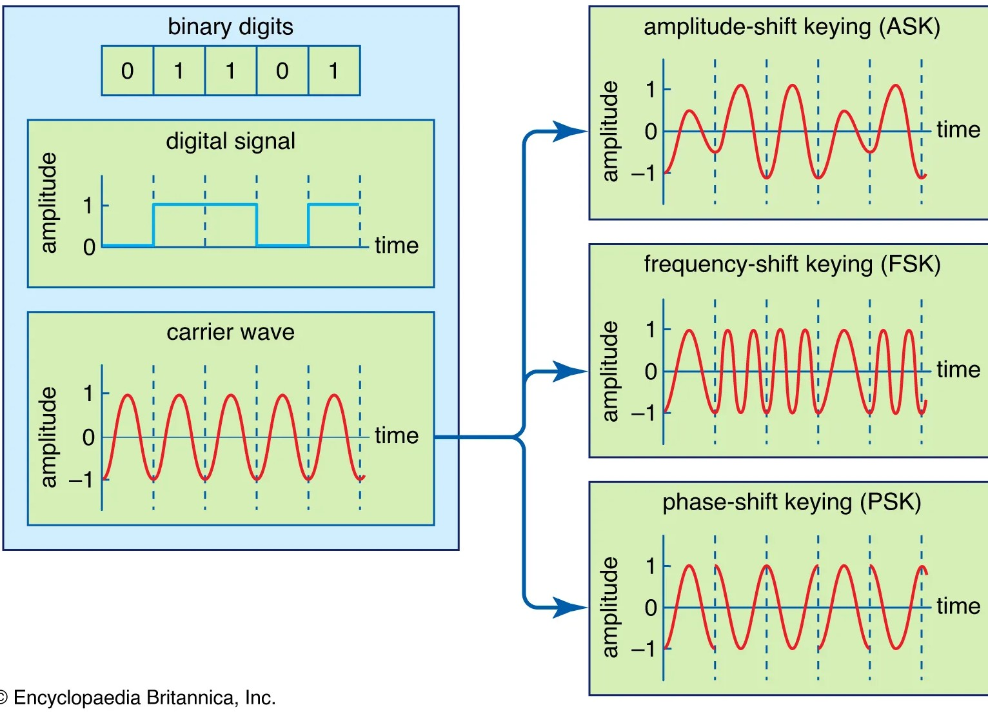
Different types of digital modulation.

Slide 13
What is Digital Transmission ?
What is Digital Transmission ?
Data can be used to represent either in analog or digital form. The computers used the digital form to store the information. Therefore, the data needs to be converted in digital form so that it can be used by a computer.

Slide 14
Digital to Digital Conversion/Encoding. .
Digital to Digital Conversion/Encoding -
The representation of digital information by a digital signal is known as digital-to-digital conversion /encoding.
In the digital-to-digital conversion/ encoding is the representation of digital information by a digital signal.
The process of converting binary 1s and 0s created by a computer into a series of voltage pulses that can be transmitted across a wire is known as digital-to-digital conversion /encoding.
This process is also known as Line Coding.
The conversion involves three techniques: line coding, block coding, and scrambling. Line coding is always needed; block coding and scrambling may or may not be needed.

Slide 15
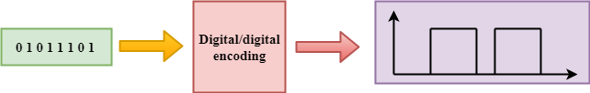
Digital to Digital Conversion / Encoding.

Slide 16
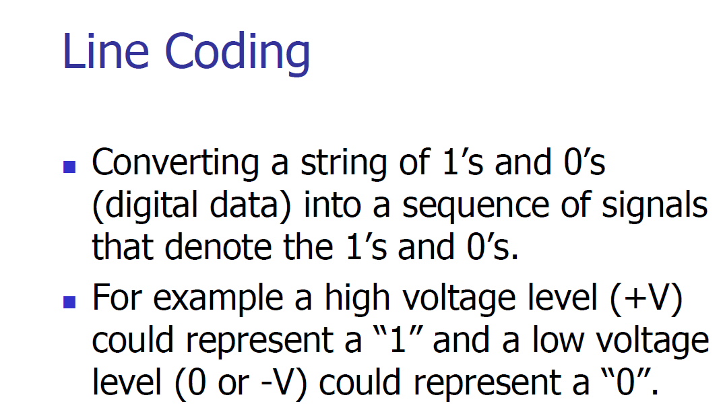
What is Line Coding ?

Slide 17
Line coding and decoding.

Slide 18
Line coding schemes.

Slide 19
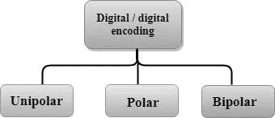
Three Types of Digital to Digital conversion / encoding .

Slide 20
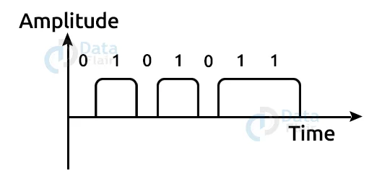
What is Unipolar digital to digital conversion / encoding ?
In the Unipolar voltage pulses are sent via a connection, such as a wire or cable, by a digital transmission system.
In most encoding schemes, one voltage level represents 0 and another voltage level represents 1.
Each pulse’s polarity decides whether it is positive or negative.
Because it only employs one polarity, this form of encoding is known as Unipolar encoding.
The polarity is allocated to the 1 binary state in Unipolar encoding whereas In Unipolar Encoding, ‘1’ represents a high voltage and ‘0’ represents a zero value.

Slide 21
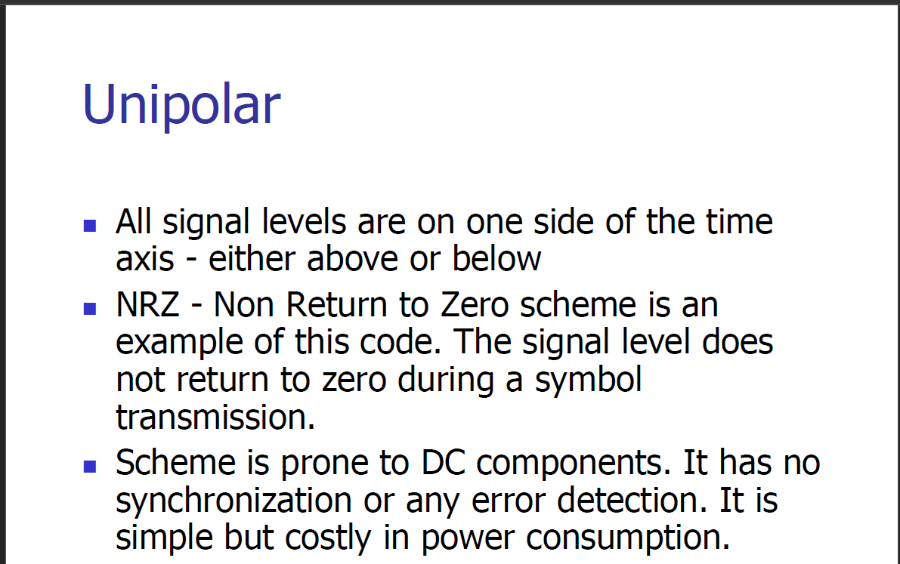
Unipolar digital to digital conversion .

Slide 22
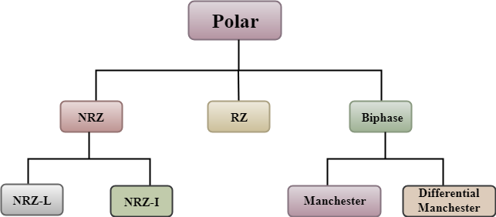
What is polar digital to digital conversion / encoding ?
Polar - Polar encoding is an encoding scheme that uses two voltage levels: one is positive, and another is negative.
By using two voltage levels, an average voltage level is reduced, and the DC component problem of unipolar encoding scheme is alleviated.

Slide 23
Types of Non return zero .
NRZ -NRZ represents about Non-return zero. In NRZ encoding, the level of the signal can be represented either or may be positive or negative.
The two most common methods used in NRZ are:
NRZ-L: In NRZ-L encoding, the level of the signal depends on the type of the bit that it represents. If a bit is 0 or 1, then their voltages will be positive and negative respectively. Therefore, we can say that the level of the signal is dependent on the state of the bit.
NRZ-I: NRZ-I is an inversion of the voltage level that represents 1 bit. In the NRZ-I encoding scheme, a transition occurs between the positive and negative voltage that represents 1 bit. In this scheme, 0 bit represents no change and 1 bit represents a change in voltage level.

Slide 24
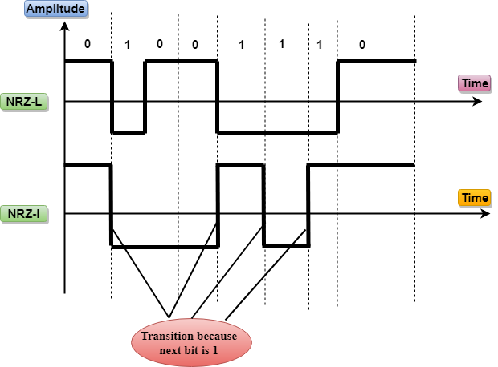
Diagram shows about NRZ-L and NRZ –I.

Slide 25
Type Return to zero.
RZ stands for Return to zero.
There must be a signal change for each bit to achieve synchronization. However, to change with every bit, we need to have three values: positive, negative and zero.
RZ is an encoding scheme that provides three values, positive voltage represents 1, the negative voltage represents 0, and zero voltage represents none.
In the RZ scheme, halfway through each interval, the signal returns to zero.
In RZ scheme, 1 bit is represented by positive-to-zero and 0 bit is represented by negative-to-zero.

Slide 26
Biphase .
Biphase - Biphase is an encoding scheme in which signal changes at the middle of the bit interval but does not return to zero.
Biphase encoding is implemented in two different ways:
Manchester - It changes the signal at the middle of the bit interval but does not return to zero for synchronization.
In Manchester encoding, a negative-to-positive transition represents binary 1, and positive-to-negative transition represents 0.
Manchester has the same level of synchronization as RZ scheme except that it has two levels of amplitude.
In Manchester and differential Manchester encoding, the transitionat the middle of the bit is used for synchronization.

Slide 27
Differential Manchester.
Differential Manchester -It changes the signal at the middle of the bit interval for synchronization, but the presence or absence of the transition at the beginning of the interval determines the bit. A transition means binary 0 and no transition means binary 1.
In Manchester Encoding scheme, two signal changes represent 0 and one signal change represent 1.

Slide 28
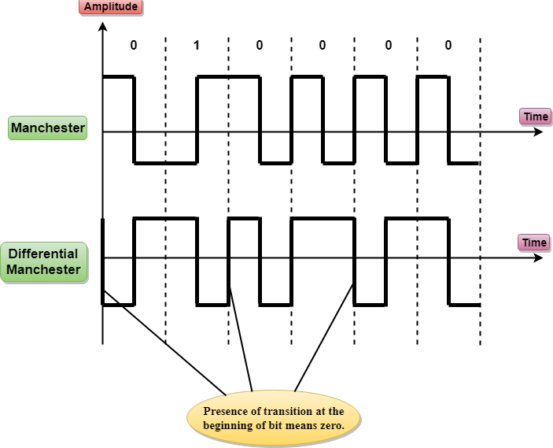

Slide 30
Third type of digital to digital transmission .
Bipolar
Bipolar encoding scheme represents three voltage levels: positive, negative, and zero.
In Bipolar encoding scheme, zero level represents binary 0, and binary 1 is represented by alternating positive and negative voltages.
If the first 1 bit is represented by positive amplitude, then the second 1 bit is represented by negative voltage, third 1 bit is represented by the positive amplitude and so on. This alternation can also occur even when the 1bits are not consecutive.

Slide 31
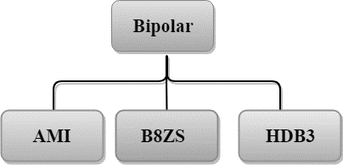
Bipolar digital to digital conversion .

Slide 32
Bipolar types .
AMI - AMI stands for alternate mark inversion where mark work comes from telegraphy which means 1. So, it can be redefined as alternate 1 inversion.
In Bipolar AMI encoding scheme, 0 bit is represented by zero level and 1 bit is represented by alternating positive and negative voltages.
B8ZS -B8ZS stands for Bipolar 8-Zero Substitution.
This technique is adopted in North America to provide synchronization of a long sequence of 0s bits.
In most of the cases, the functionality of B8ZS is similar to the bipolar AMI, but the only difference is that it provides the synchronization when a long sequence of 0s bits occur.

Slide 33
HDB3 Bipolar type.
HDB3 -HDB3 stands for High-Density Bipolar 3.
HDB3 technique was first adopted in Europe and Japan.
HDB3 technique is designed to provide the synchronization of a long sequence of 0s bits.
In the HDB3 technique, the pattern of violation is based on the polarity of the previous bit.

Slide 34

Thanks

